Slide 1

Advisors. Architects. Applications

Slide 2
Multi-Tenant Invoice Management System
Prepared By :
Ashish Singh Parihar
Guided By :
Mr. Manoj Kumar Singh

Slide 3
Agenda
Introduction
4+1 Diagrams
E-R Diagram
Application Snapshots
Technology Used
Thank You

Slide 4
Introduction
This is a Online Multi-Tenant Invoice Management System. Any company can register with the system and perform the following actions:
Add users to the system. A user can be an admin or a normal user.
A Normal User Can Do:
Update his/her profile.
Create/Manage an Item.
Create/Manage a Client .
Create/Manage Invoice of Clients.
A Admin User Can do in Addition to Normal User:
Manage Users in the system
Upload a “XML” file containing client list .
Export the summary of invoices in excel format.

Slide 5
Use Case Diagrams

Slide 6
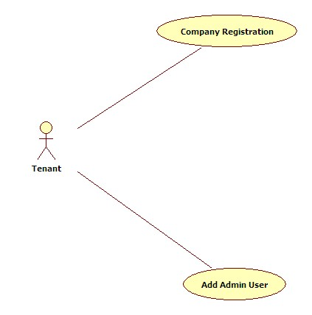
Tenant

Slide 7
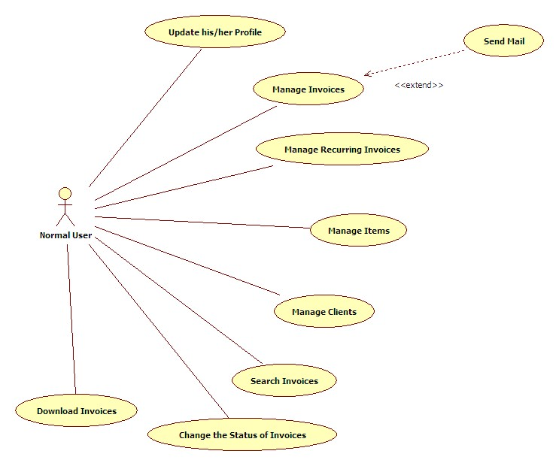
Normal User

Slide 8
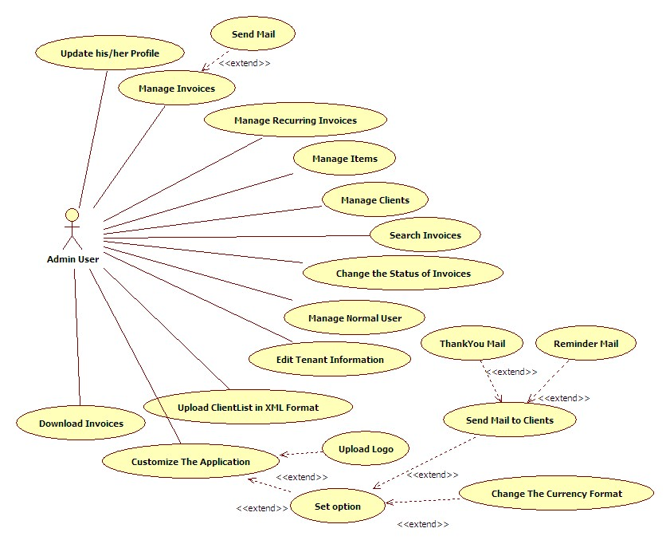
Admin User

Slide 9
Class Diagrams

Slide 10
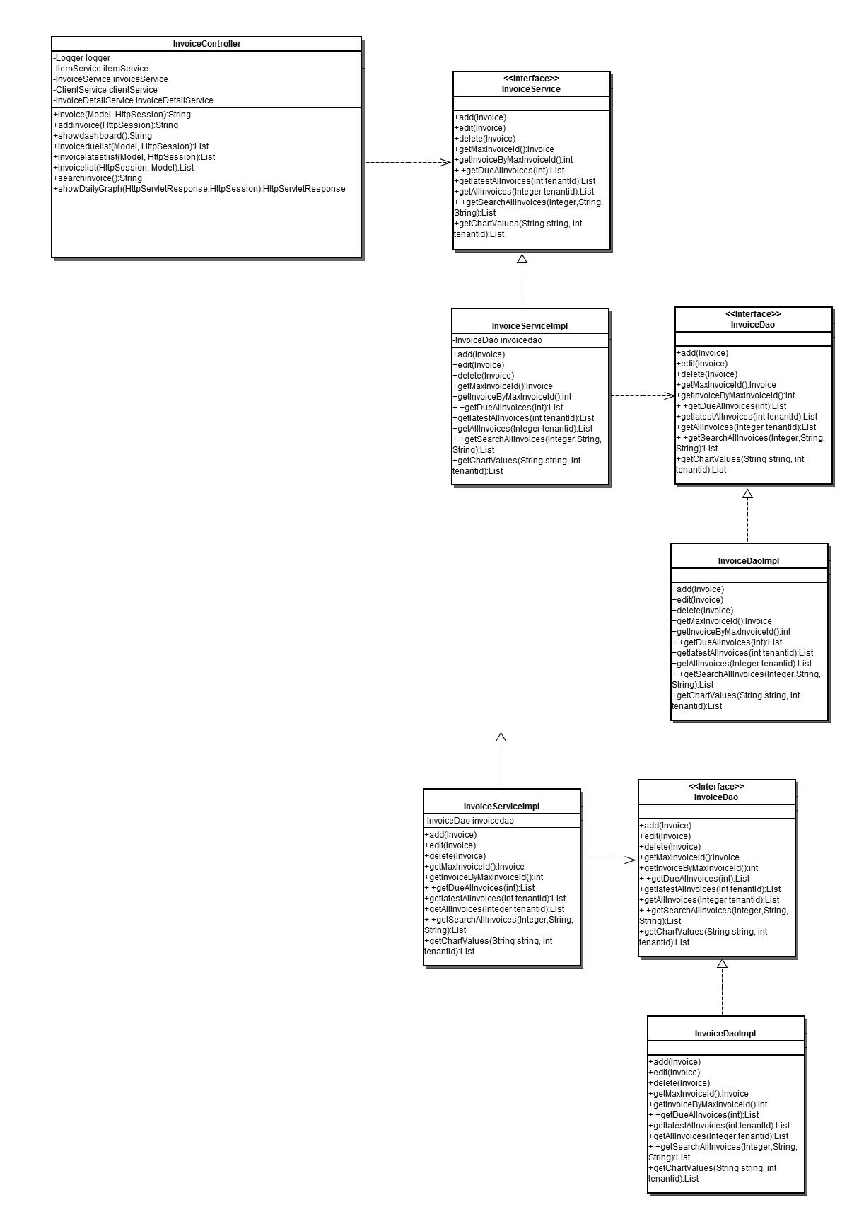
Invoice

Slide 11
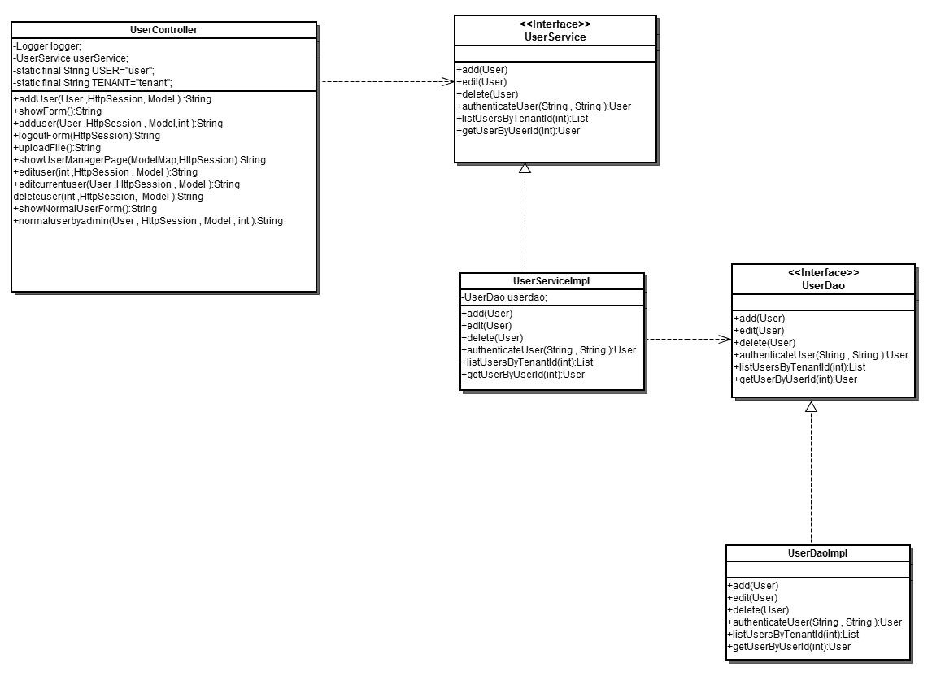
User

Slide 12
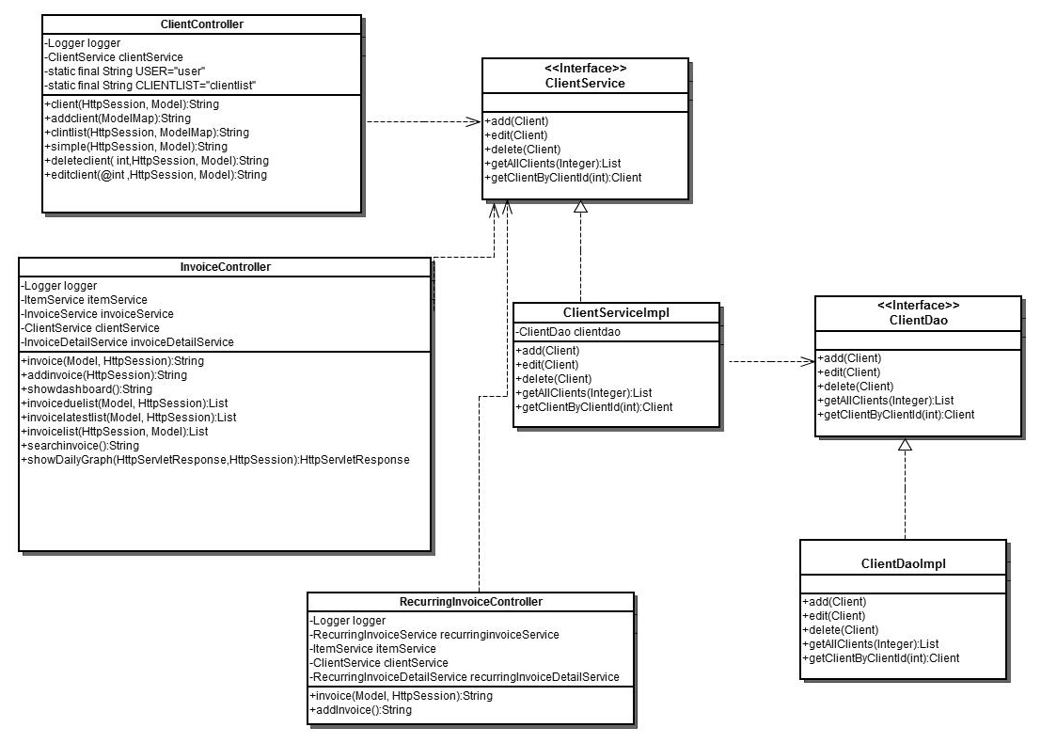
Client

Slide 13
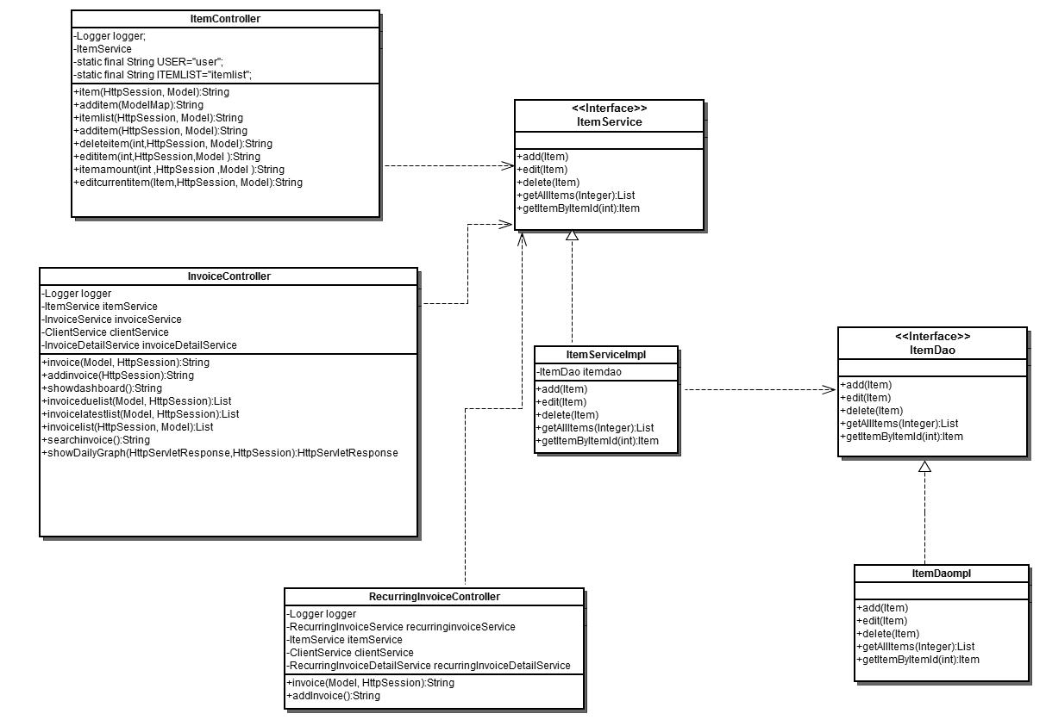
Item

Slide 14
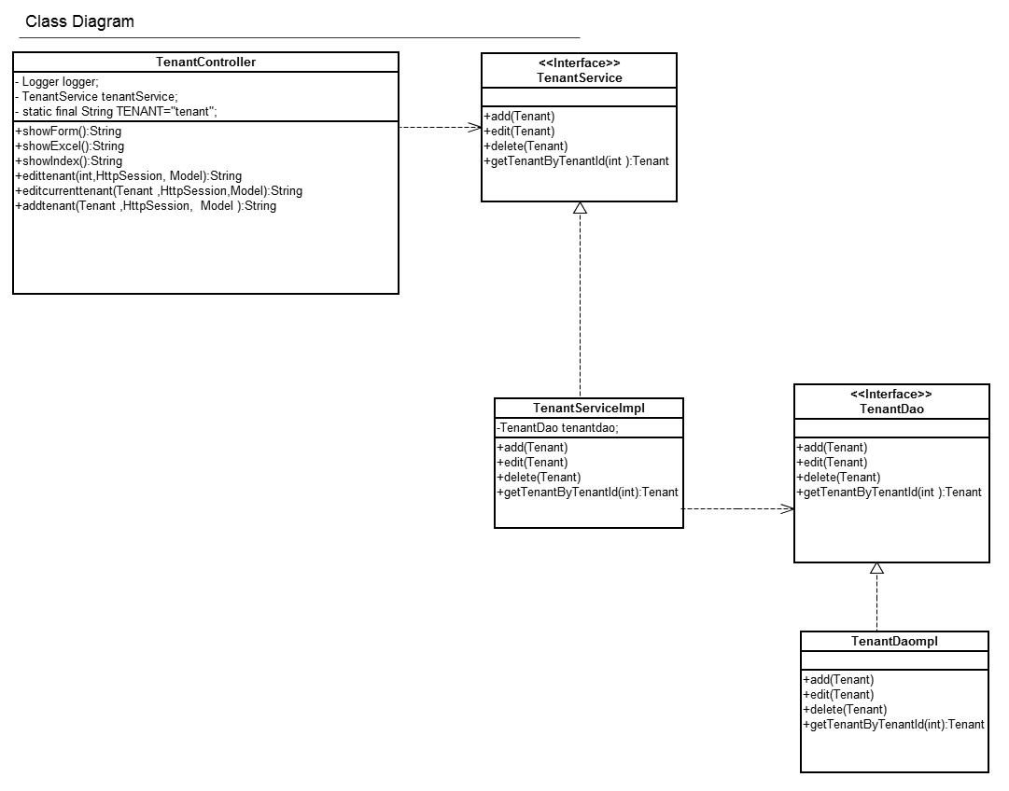
Tenant

Slide 15
Sequence Diagrams

Slide 16
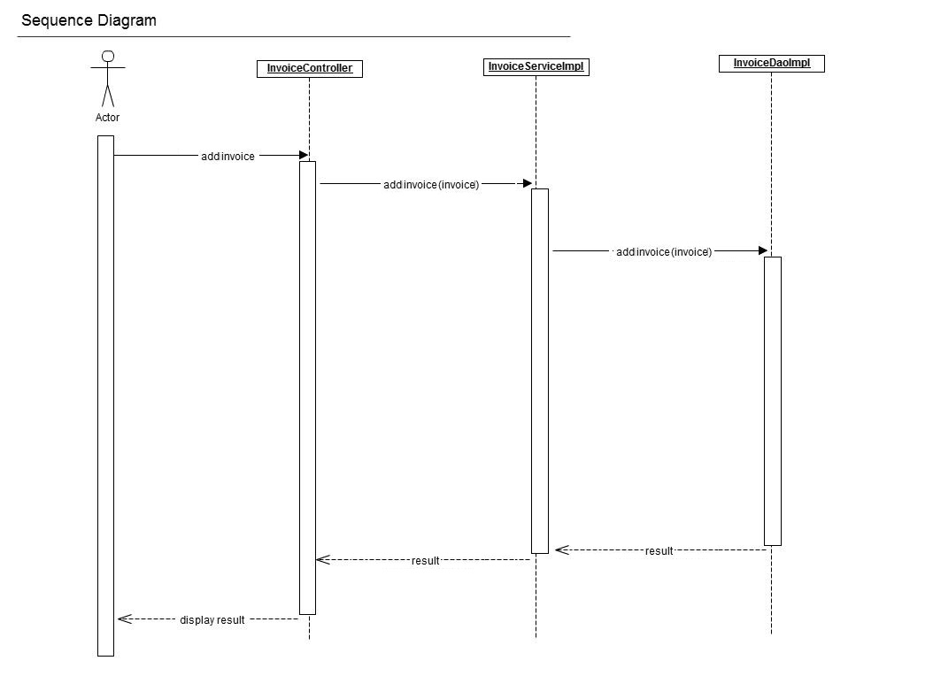
Invoice(add_invoice)

Slide 17
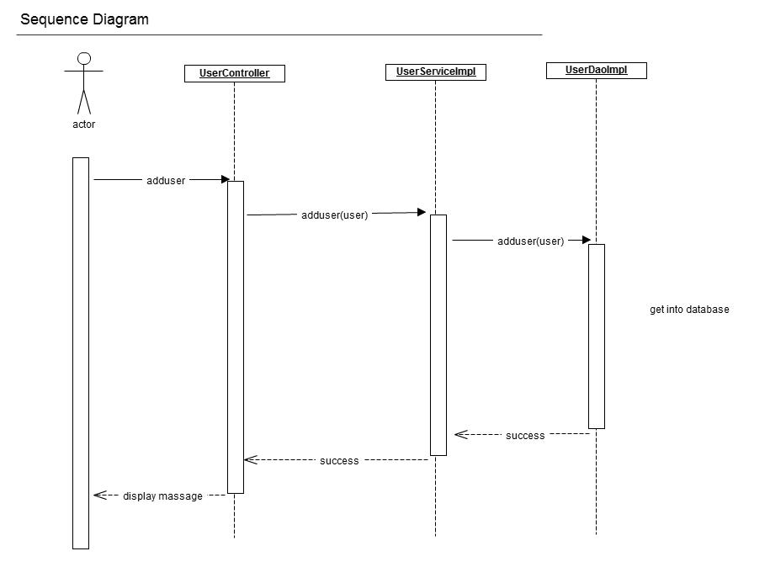
User(add_user)

Slide 18
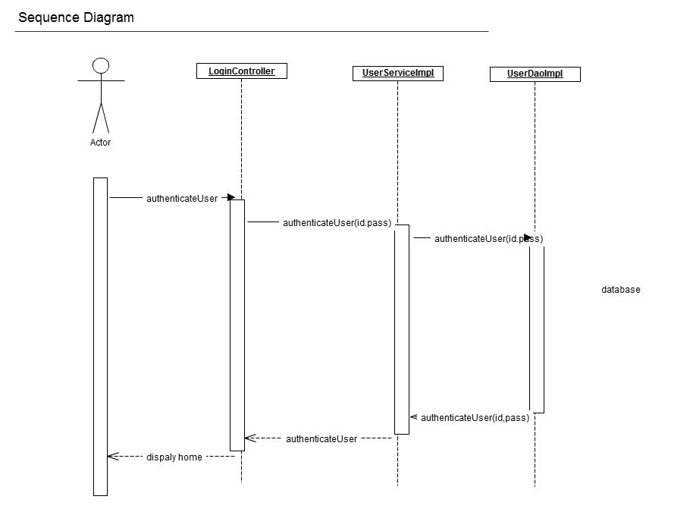
Login

Slide 19
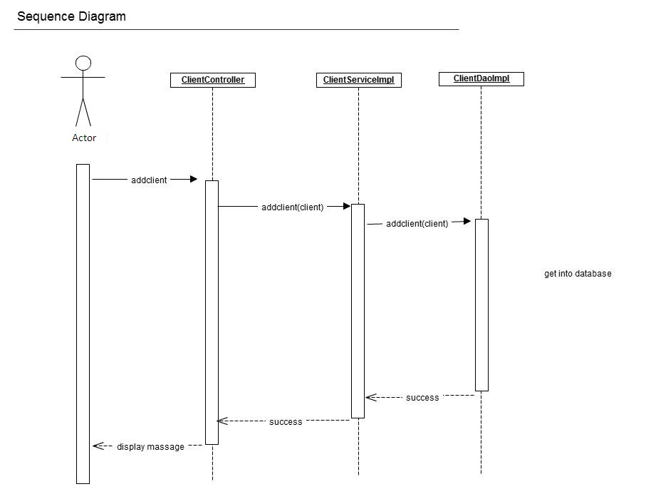
Client(add_client)

Slide 20
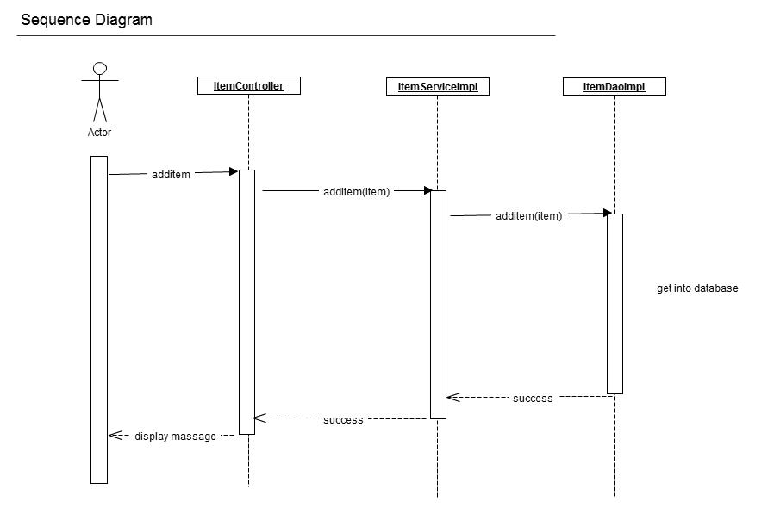
Item(add_item)

Slide 21
Deployment Diagrams

Slide 22
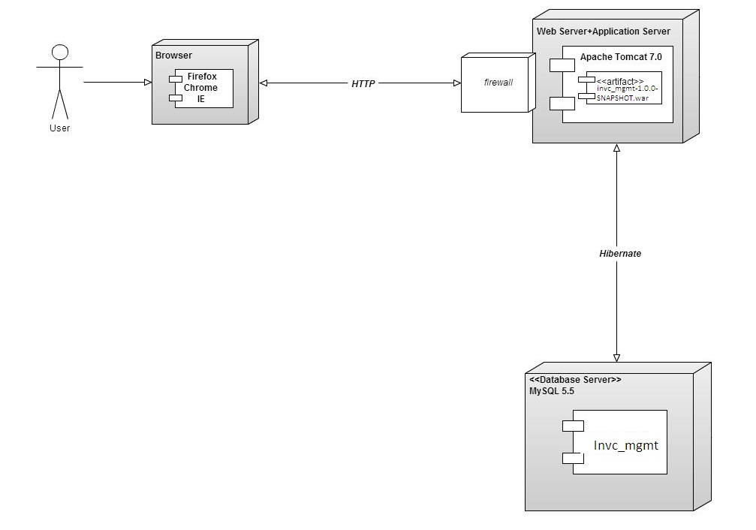

Slide 23
Activity Diagrams

Slide 24
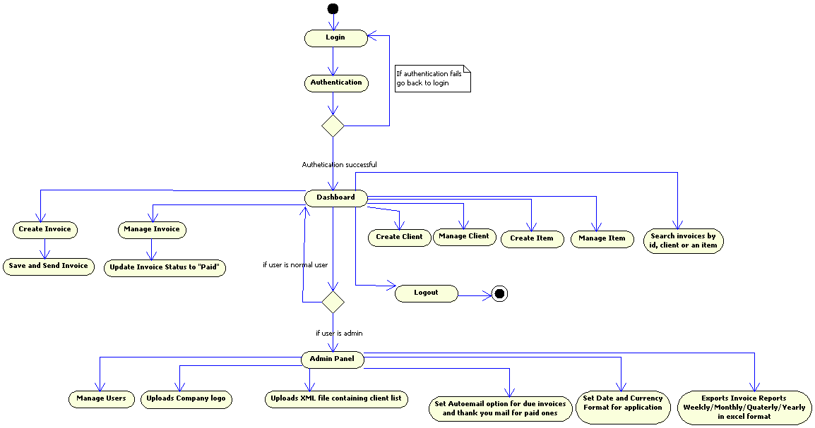

Slide 25
E-R Diagrams

Slide 26
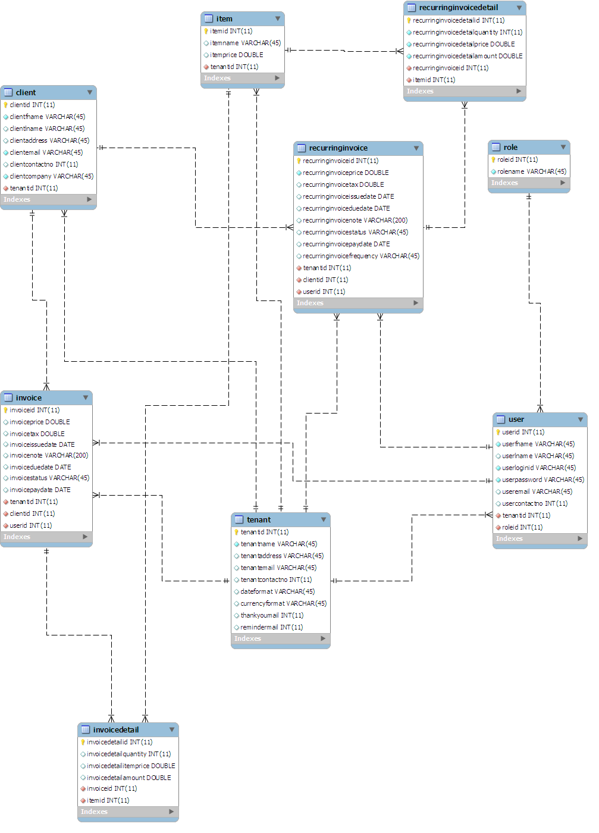

Slide 27
Attached Document
Java Docs

Slide 28
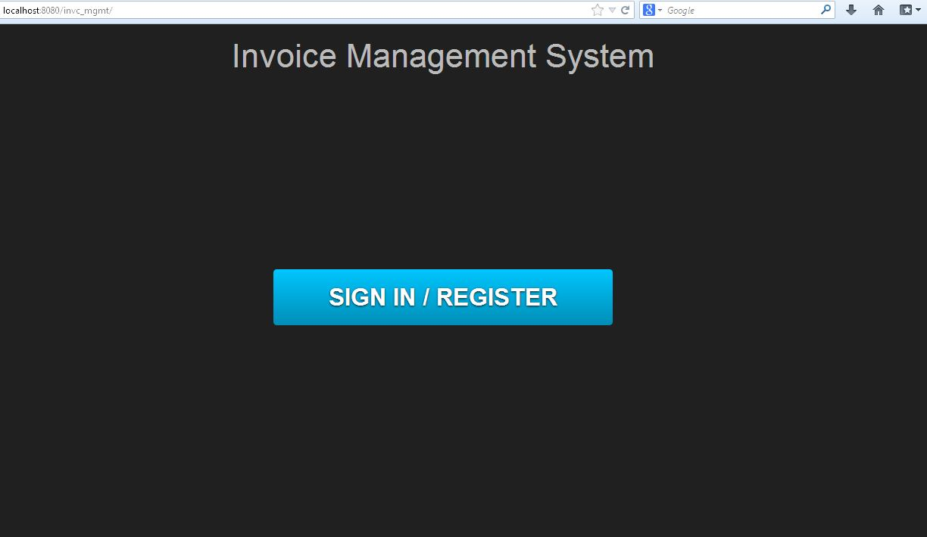
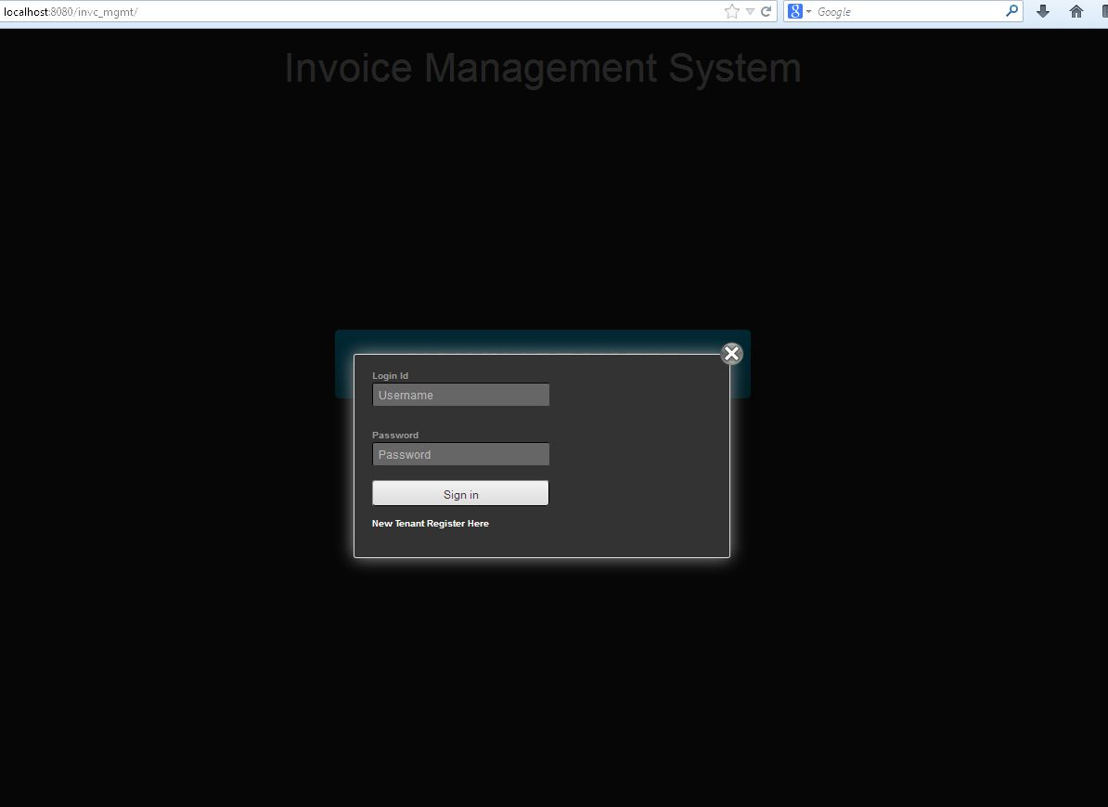
Application Demo
http://localhost:8080/invc_mgmt/

Slide 29
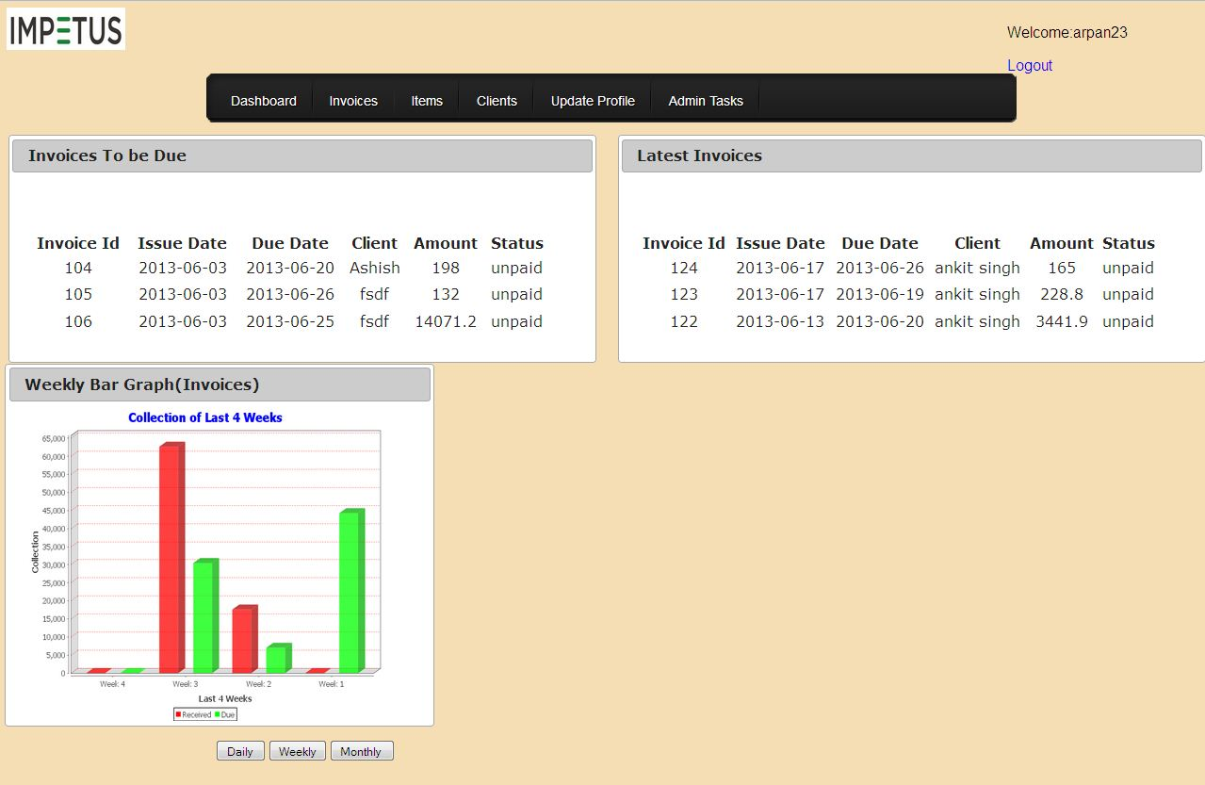
http://localhost:8080/invc_mgmt/userlogin.html

Slide 30
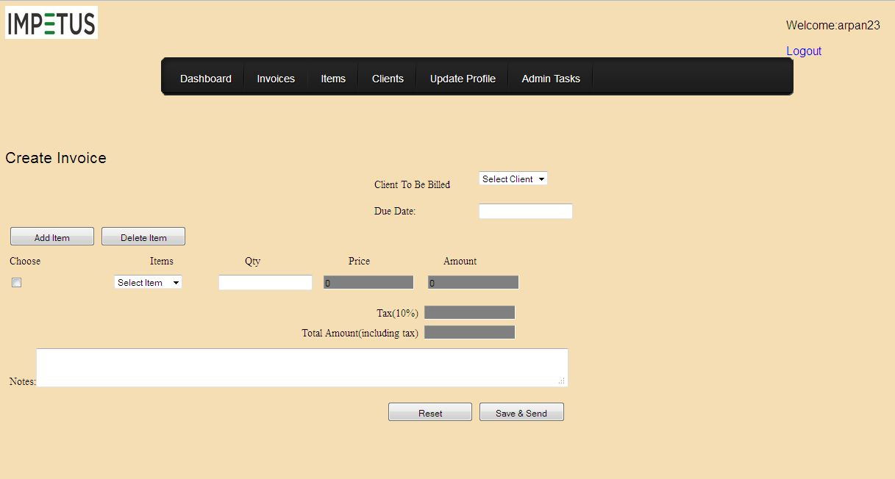
http://localhost:8080/invc_mgmt/invoice.html

Slide 31
Technology Used

Slide 32
Application framework: Spring 3.2.1 MVC
Back-End ORM Technology: Hibernate 4.1.9
Build Tool: Apache Maven
Database: My SQL 5.1
Logging Framework: Log4j 1.2.17

Slide 33
Thank You

